Slide 1

1D Rydberg atom arrays: An entry point to studying isolated quantum many body systems out of equilibrium
Name: Oliver Lind
Supervisor: Prof. Stuart Adams
Notes:
I am going to give talk 1D Rydberg atom arrays
And how these systems are a really interesting entry point to studying isolated quantum systems

Slide 2
Background to the project
Two competing ideas
Notes:
- This graph is not going to make much sense but this was the starting point of the project
-motivated by the paper below
-What it shows is ordered behavior arising from a quantum system push out far from equilibrium
- What we would learn is that is what underlies it is very deep. We were scratching the tip of the iceberg.

Slide 3
Motivation
Classical Isolate system
Adiabatic walls (no transfer of heat outwards)
Balloon with ideal gas inside
Rest of the chamber is a vacuum
Vacuum
Notes:
Let’s look at what happen in we initial start out of equilibrium in an classical isolated system
Adiabatic walls so isolate
Balloon with an ideal gas inside
Peirce the balloon

Slide 4
Motivation
Classical Isolated System
Adiabatic walls (no transfer of heat outwards)
Balloon with ideal gas inside
Rest of the chamber is a vacuum
Peirce the balloon
Out of equilibrium initial state
Notes:
Peirce the balloon
Out of equilibrium state

Slide 5
Motivation
Classical Isolated System
Adiabatic walls (no transfer of heat outwards)
Balloon has N particles with total energy E
Rest of the chamber is a vacuum
Peirce the balloon
Air particles spread
Out of equilibrium state
Notes:
Evntually if we

Slide 6
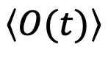
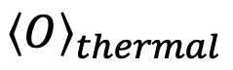
Motivation
Classical Isolated System
Adiabatic walls (no transfer of heat outwards)
Balloon has N particles with total energy E
Rest of the chamber is a vacuum
Peirce the balloon
Air particles spread
System thermalizes
Macroscopic observables reach steady average value:
$$\left\langle O(t)\right\rangle$$
$${\left\langle O\right\rangle }_{thermal}$$
Reaches Equilibrium

Slide 7
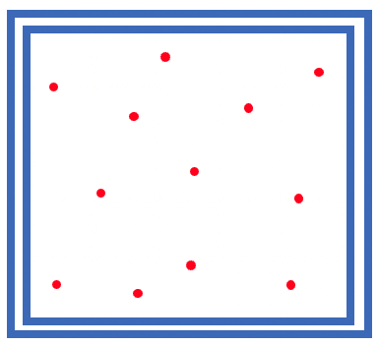
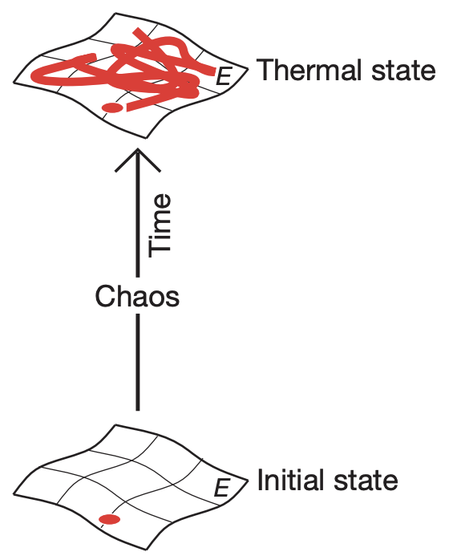


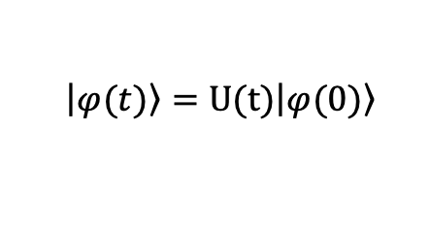

Motivation
Statistical Physics
What happens in an isolated quantum system?
Unitary time evolution
Maximum Entropy
$$\left|\left.φ(t)\right\rangle \right.=U(t)\left|\left.φ(0)\right\rangle \right.$$
Can the system thermalize in the same way?
Can we associate entropy in the same way?
Are there global properties that can help us understand this?
Low Entropy
Notes:
Statiscal physics tells us this system explores every possible configuration in phase as a result of dynamical choas
Initial conditions of the system don’t matter and eventually get lost
Entropy is maximised as the system thermalise
What happens in an isolated quantum system
Unitary time evolution is linear, reversible initial state is encoded throughout
So in a way it is not forgotten

Slide 8
Motivation
Statistical Physics
What happens in an isolated quantum system?
Unitary time evolution
Discrete energy levels
Heinsberg's uncertainty principle
Maximum Entropy
Studying out of equilibrium dynamics of isolated quantum systems
1D Rydberg atom arrays quantum simulators
Entry point
Can the system thermalize in the same way?
Can we associate entropy in the same way?
Are there global properties that can help us understand this?
Low Entropy
Notes:
1D Rydberg atom arrays is a great entry point to study questions like these

Slide 9
Contents
Introduce the model
Rydberg Atoms
Rydberg Blockade
Ising Type Hamiltonian
Forming Crystals
Bringing the system out of equilibrium
Global quench
Local quech
Further work

Slide 10
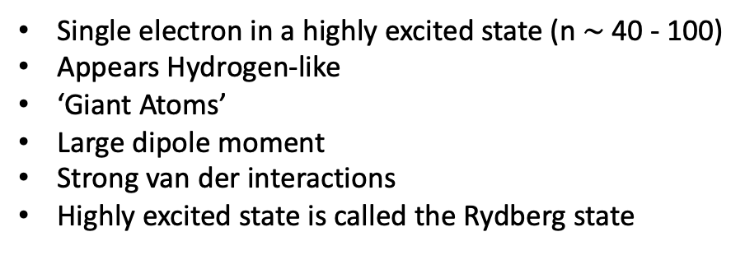
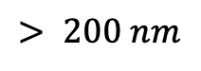
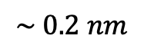
Rydberg Atoms: What are they?
Single electron in a highly excited state (n $\sim$40 - 100)
Appears Hydrogen-like
‘Giant Atoms’
Large dipole moment
Strong van der interactions
Highly excited state is called the Rydberg state
+
Size
$$\sim 0.2 nm$$
$$> 200 nm$$
Notes:
Atoms with an electron in a highly excited state
Delocalized and far away from the atom appear hydrogen like
Large dipole moment amongst a lot of other interesting properties

Slide 11
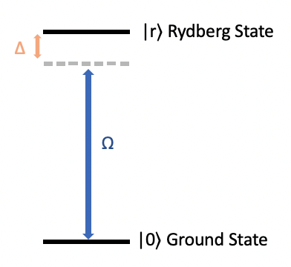
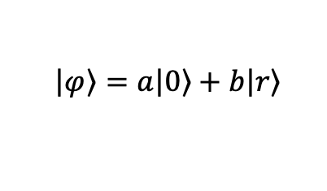
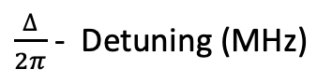
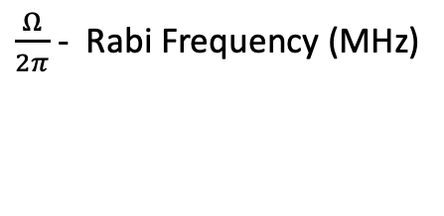
Rydberg Atoms: Encoding as qubit
Use a laser to couple Ground and Rydberg states of atom
Two level system forms our qubit
$$\left|\left.φ\right\rangle \right.=a\left|\left.0\right\rangle \right.+b\left|\left.r\right\rangle \right.$$
Driving Laser
$\frac{Ω}{2π}$ - Rabi Frequency (MHz)
Strength of coupling between states
$\frac{∆}{2π}$ - Detuning (MHz)
How far of resonance driving laser is
Notes:
Laser to couple Ground and Rydberg states
Two level system form our quibit
Strength of coupling between states and is associated with the amplitude to the laser

Slide 12
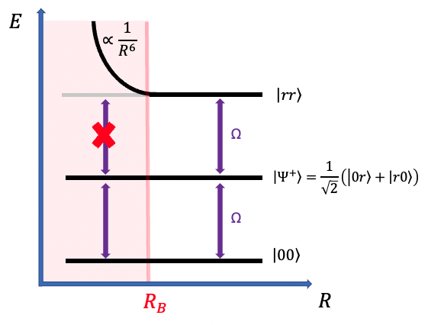
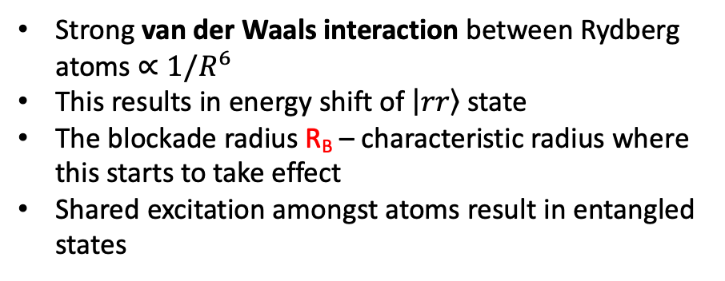
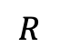
Interaction and Rydberg Blockade
Two atoms
$$R$$
Strong van der Waals interaction between Rydberg atoms $∝1/R^{6}$
This results in energy shift of $\left|\left.rr\right\rangle \right.$ state
The blockade radius R_{B} – characteristic radius where this starts to take effect
Shared excitation amongst atoms result in entangled states
Notes:
Now lets introduce interaction
Consider two atoms separated by a distance R
Strong van der waals interaction between Rydberg atoms
This results in an energy shift of doubly excited state
So if to atoms are close together can’t drive to the rr state

Slide 13
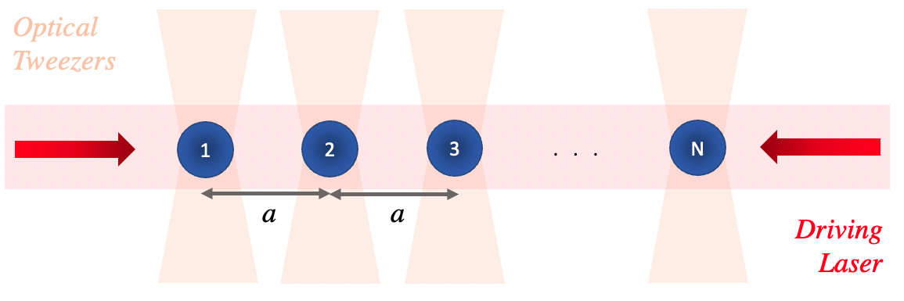
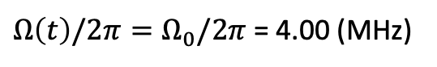
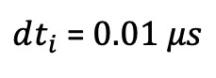
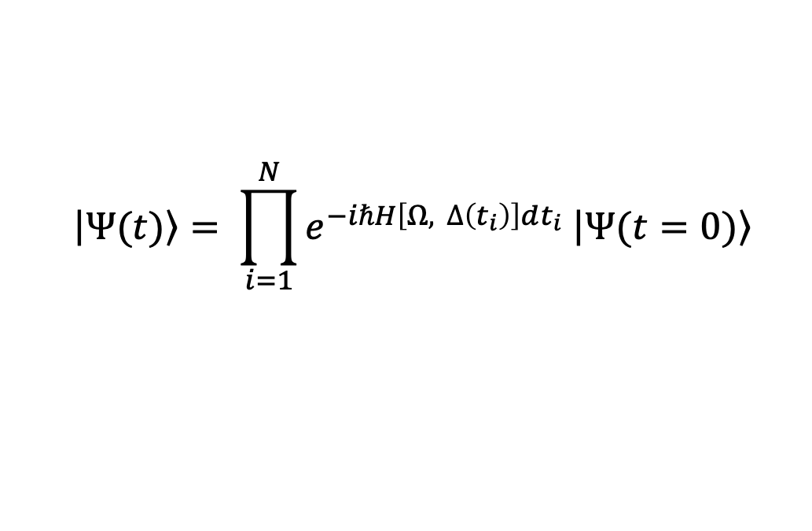
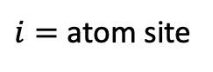
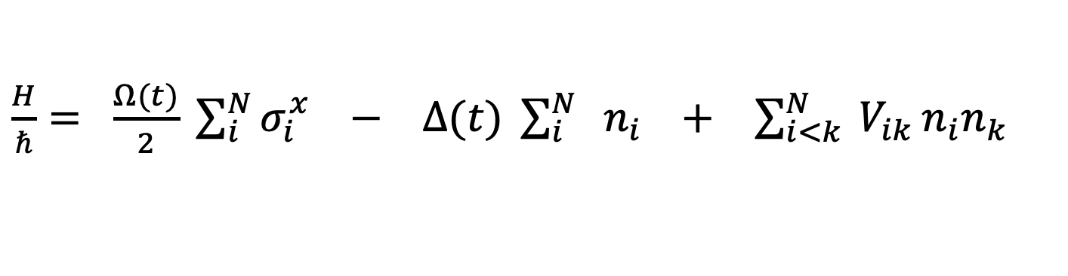
Many Body Hamiltonian
Evolve the system with Trotter-Suzuki decomposition:
$$\left|\left.Ψ(t)\right\rangle \right.= \prod_{i=1}^{N}{e^{−iℏH\left[Ω, ∆\left(t_{i}\right)\right]dt_{i}} \left|\left.Ψ(t=0)\right\rangle \right.}$$
$dt_{i}$ =$0.01 μs$
$\frac{H}{ℏ}= \frac{Ω(t)}{2} \sum_{i}^{N}{σ_{i}^{x}} −$ $∆(t) \sum_{i}^{N}{ { n}_{i}}$ $+$ $\sum_{i<k}^{N}{ V_{ik}}n_{i}n_{k}$
$i=$ atom site
Driving term
Detuning term
Interaction term
$Ω\left(t\right)/2π=Ω_{0}/2π$ = 4.00 (MHz)
Notes:
Put all these component into a Hamiltonian
First set up
Consider an array of N atoms equidistant from each other in a chain
Hamiltonian in three parts
First term coupling between ground and Rydberg states for each atom due to driving laser
Second tells how far of resonance laser is
Third is responsible for the interaction of Rydberg states
(Not doing justice to the inrceble experimental techjniques that trap atoms)
To numercally solve the schrodinger equation we will evolve of system with trotter sucuki decomposition
Taking dtt = 0.01 microseconds
And our Rabi frequency we will set constant to 4 (MHz)

Slide 14
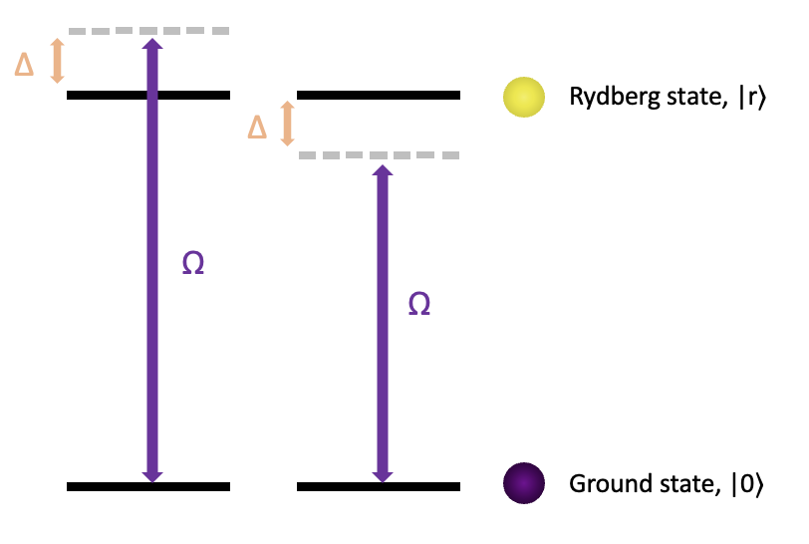
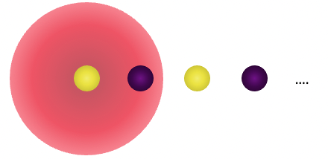
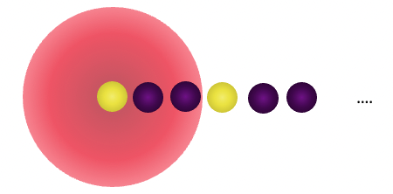
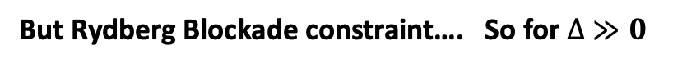

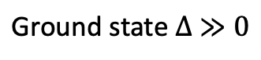
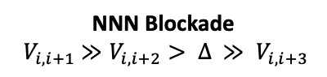
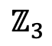
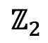
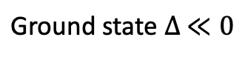
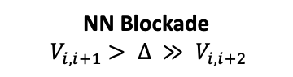
Using blockade to generate ordered states
$$\text{Ground} \text{state} ∆ ≪0$$
$$\text{Ground} \text{state} ∆ ≫0$$
But Rydberg Blockade constraint…. So for $∆ ≫0$
$$ℤ_{2}$$
$$ℤ_{3}$$
NN Blockade
$${ V}_{i, i+1} > ∆ ≫ V_{i, i+2}$$
NNN Blockade
$${ V}_{i, i+1} ≫V_{i, i+2}> ∆ ≫ V_{i, i+3}$$
Note:
Focus NN Blockade
Odd number of sites (No degeneracy in our $∆ ≫0$ ground states)
Notes:
Positive detuning is upwards
Laser is below resonance all in the ground state
Laser is above resonance all in the excited state
But Rydberg B constaint
So subject to this constraint we get ordered stated
NN the Z2
Odd number of sites
No degeneracy in high detuning ground states
Due to symmetry

Slide 15

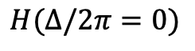
Taking the system out of equilibrium
$$H(∆/2π=0)$$
Notes:
What if we intend to go quick and break adaiabaticy
Analogous to a metal work hot metal cold wate
What sort of behaviour do we expect

Slide 16
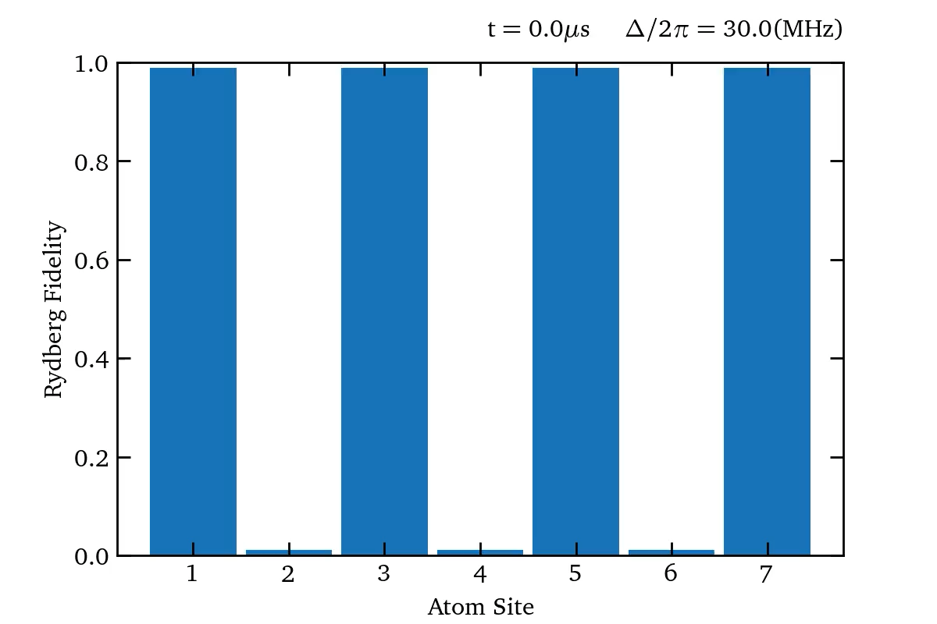
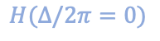
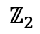
Taking the system out of equilibrium
$$ℤ_{2}$$
$$H(∆/2π=0)$$
Notes:
We can run the same simulation this time starting from the z2 ordered state
Nice order oscillations and revivals of initial z2
As before look at eigenenergies
This time of quenched system

Slide 17

What if we intend on going quickly: quenches
Ordered behavior arises despite large spreading across many degrees of freedom
Initial state revival
Quantum scar effect
‘Weak ergodicity breaking’ behavior
Graphs don’t give the whole picture
Correlations between atoms
Entanglement
Notes:
Plotting a colormap we can see clearly this revivals of the initial state

Slide 18


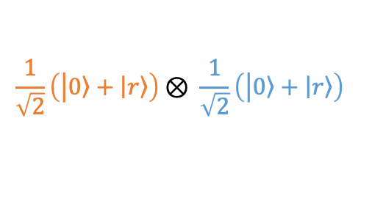
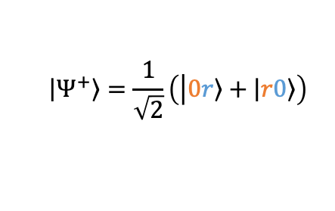
Entanglement: can this offer us any further insight?
Two qubits
Product states
$$\frac{1}{\sqrt{2}}\left(\left|\left.0\right\rangle +\left|\left.r\right\rangle \right.\right.\right)⊗ \frac{1}{\sqrt{2}}\left(\left|\left.0\right\rangle +\left|\left.r\right\rangle \right.\right.\right)$$
Atom 1
Atom 2
Entangled states
$$\left|\left.Ψ^{+}\right\rangle \right.=\frac{1}{\sqrt{2}}\left(\left|\left.0r\right\rangle +\left|\left.r0\right\rangle \right.\right.\right)$$
Need Atom 2 to fully describe the state of atom 1

Slide 19
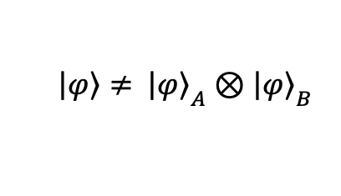
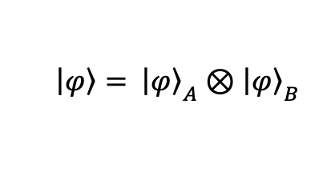
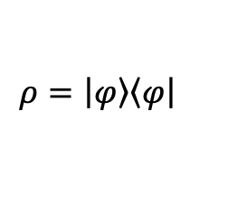
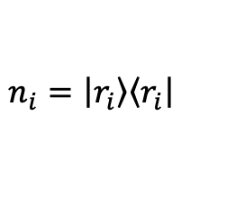

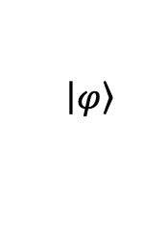
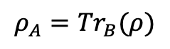
Entanglement Entropy
$$\left|\left.φ\right\rangle \right.$$
Density Matrix
$$ρ=\left|\left.φ\right\rangle \right.\left\langle \left.φ\right|\right.$$
$\left|\left.φ\right\rangle = \right.$ ${\left|\left.φ\right\rangle \right.}_{A}$ $⊗{\left|\left.φ\right\rangle \right.}_{B}$
$\left|\left.φ\right\rangle ≠ \right.$ ${\left|\left.φ\right\rangle \right.}_{A}$ $⊗{\left|\left.φ\right\rangle \right.}_{B}$
A
B
Reduced Density Matrix
$$ρ_{A}={Tr}_{B}(ρ)$$
Everything we can know about A without B
$$n_{i}=\left|\left.r_{i}\right\rangle \right.\left\langle \left.r_{i}\right|\right.$$
Von Neuman Entropy Between A and B
How uncertain is the information in $ρ_{A}$

Slide 20
So why is this interesting?
Some of the further work we have done:

Slide 21
How does single addressing change things?
New dimensionality , propagation through the system

Slide 22
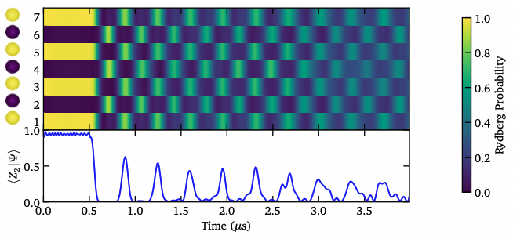
So where do we go from here?
Graphs don’t give the whole picture
Correlations between atoms
Entanglement
Probing entanglement dynamics in the system:
Propagation (Lieb Robinson bounds..)
Scaling (Area vs Volume Law…)

Slide 23
Acknowledgements

Slide 24
Values

Slide 25
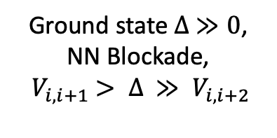
Using Blockade to generate ordered states
$$\text{Ground} \text{state} ∆ ≪0$$
$$\text{Ground} \text{state} ∆ ≫0$$
But Rydberg Blockade constraint….
$\text{Ground} \text{state} ∆ ≫0$,
NN Blockade,
${ V}_{i, i+1} > ∆ ≫ V_{i, i+2}$

Slide 26
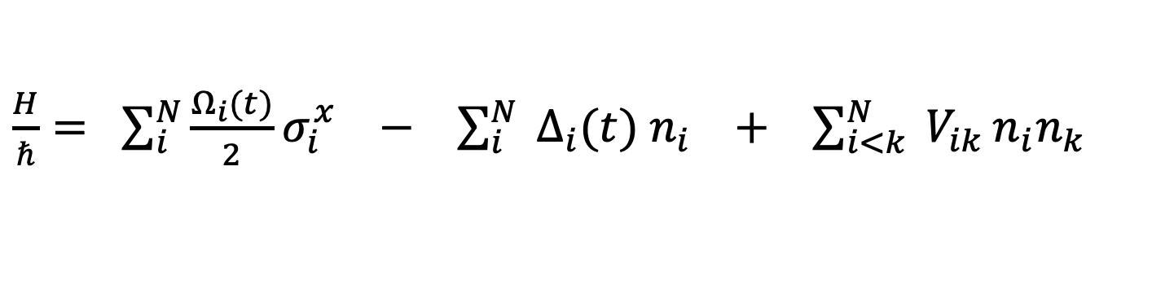
Many Body Hamiltonian: Single site addressing
Evolve the system with Trotter-Suzuki decomposition:
$$\left|\left.Ψ(t)\right\rangle \right.= \prod_{i=1}^{N}{e^{−iℏH\left[Ω, ∆\left(t_{i}\right)\right]dt_{i}} \left|\left.Ψ(t=0)\right\rangle \right.}$$
$\frac{H}{ℏ}= \sum_{i}^{N}{\frac{Ω_{i}(t)}{2}σ_{i}^{x}} −$ $\sum_{i}^{N}{ ∆_{i}(t){ n}_{i}}$ $+$ $\sum_{i<k}^{N}{ V_{ik}}n_{i}n_{k}$
$i=$ atom site
Driving term
Detuning term
Interaction term

Slide 27
Entanglement: can this offer us any further insight?
Entanglement Entropy
3

Slide 28
We then went on to look at…..

Slide 29
New Slide
Growing, scaling and propagation of entanglement within the system is important way to begin to understand what is going on in the out of equilibrium regime

Slide 30
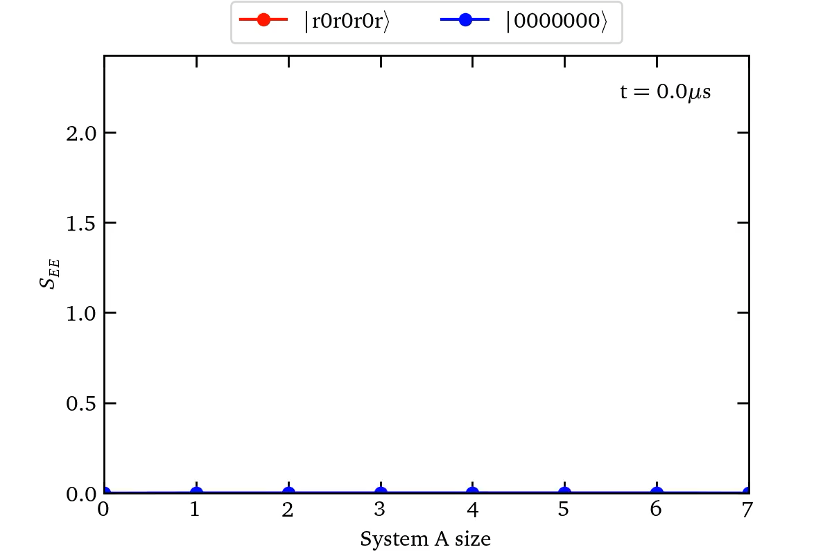
Interaction and Rydberg Blockade

